Slide 1
Enhancing Retail Experiences - DBMS in E-commerce Platform
Submitted To:
Dr. Fernaz Narin Nur (Associate Professor)
Department of CSE
Submitted By:
Shazidul Alam_09
Anisur Rahman Naeem_15
Faisal Morshed Akash_07
Batch: CSE-19
1

Slide 2
Contents of this template
Here’s what you’ll find in this template:
1) Objective
2) Motivation
3) E-R Diagram
4) Schema
2

Slide 3
Objective
Investigating the impact of DBMS on e-commerce platforms for management. 1) Customer 2) Product 3) Billing 4) Feedback
3

Slide 4
Motivation
The motivation behind investigating the impact of Database Management Systems (DBMS) on e-commerce platforms for managing product catalogs, order processing, and customer interactions is rooted in the fundamental transformations that DBMS brings to the retail landscape. In the context of online retail, where competition is fierce and consumer expectations are continually evolving, leveraging DBMS becomes essential for staying ahead of the curve.
4

Slide 5
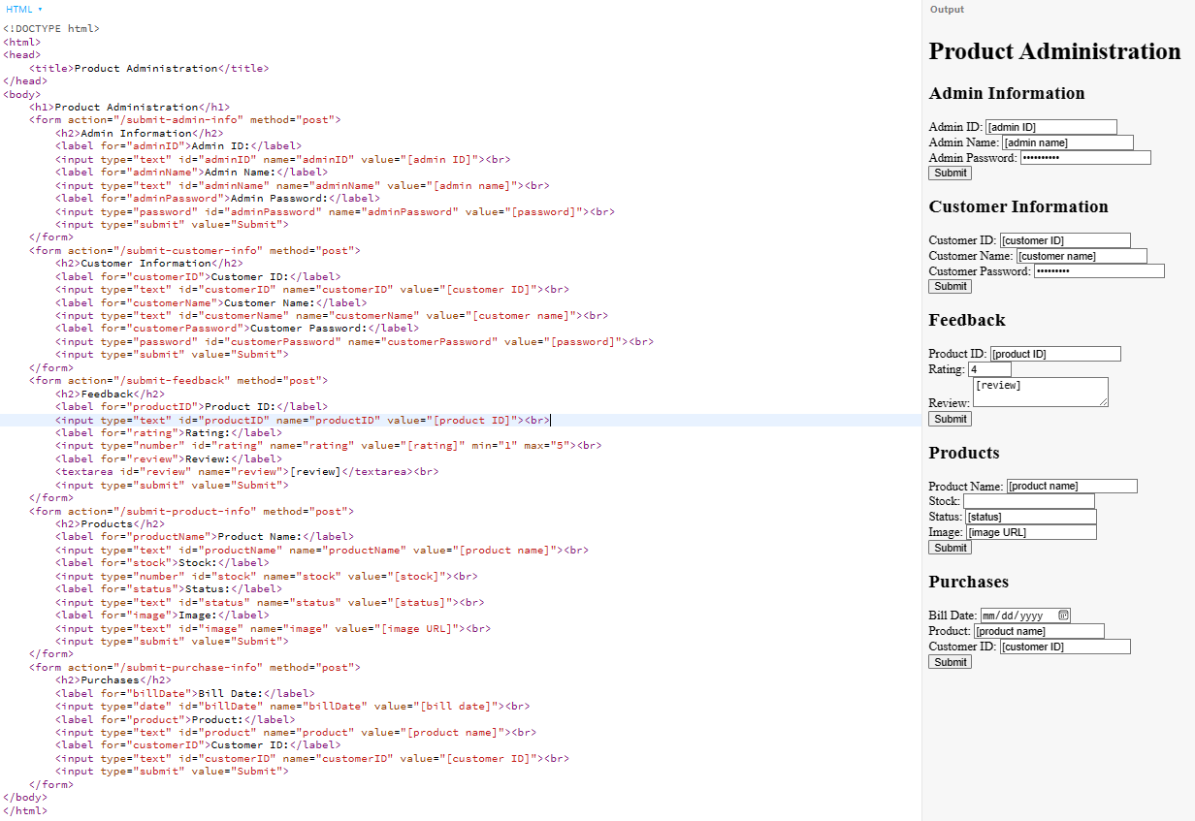
Sample Webpage
5

Slide 6
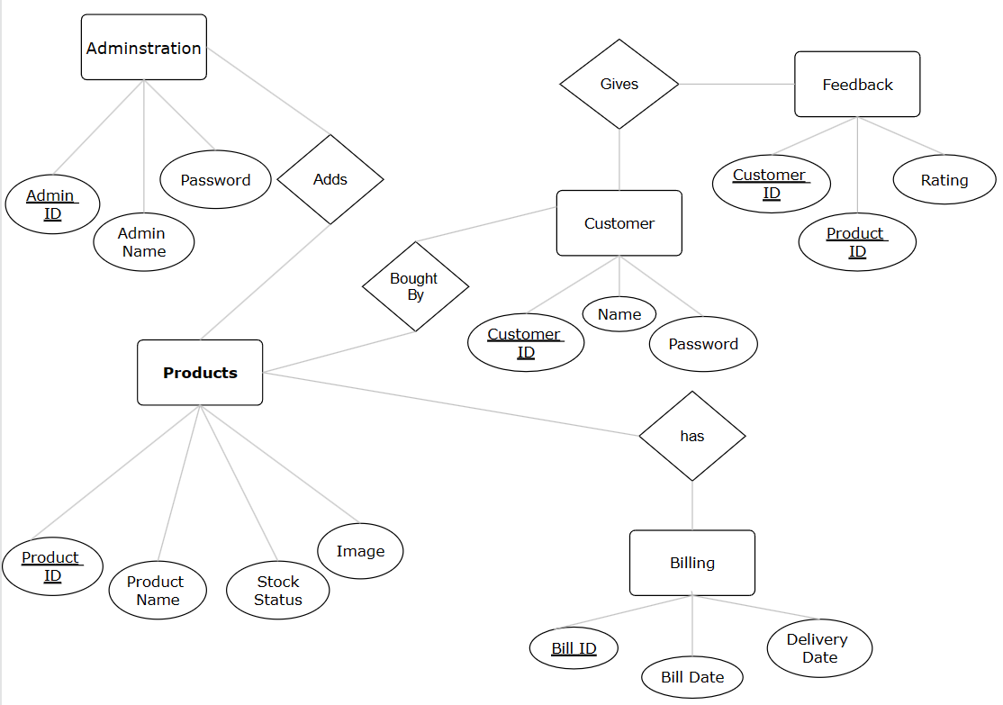
E-R Diagram of E-Commerce Platform
ER Diagram created from Smartdraw.com
6

Slide 7
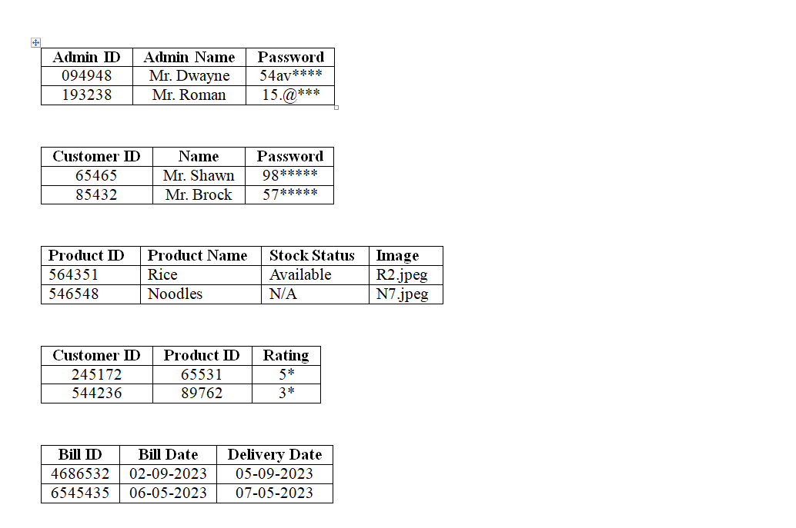
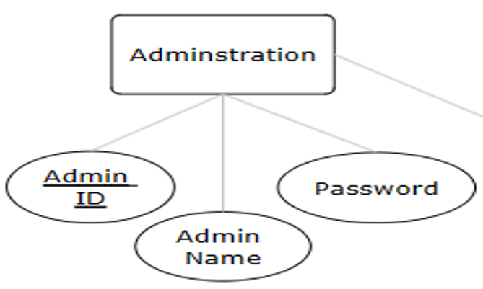
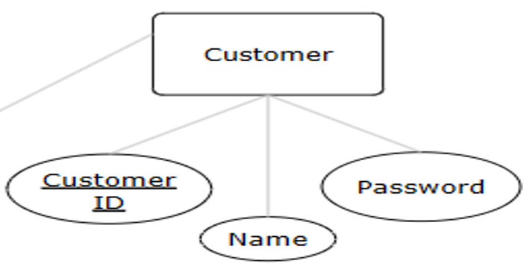
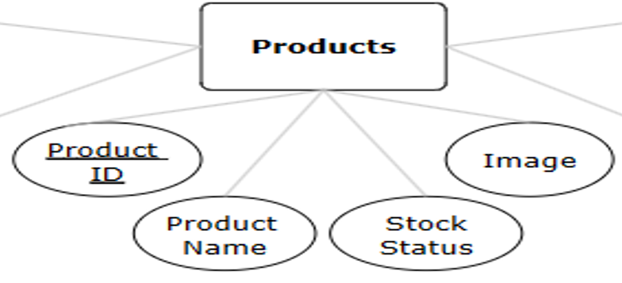
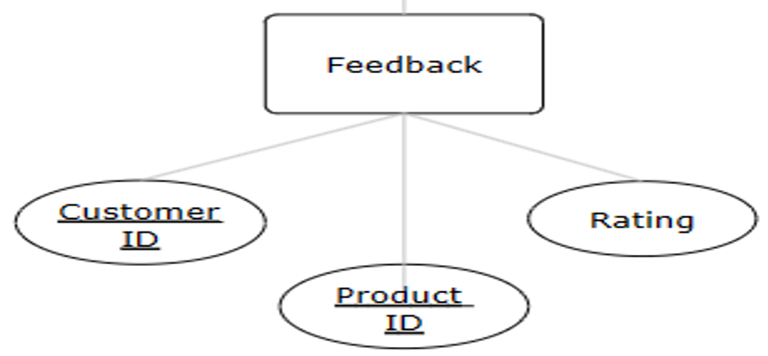
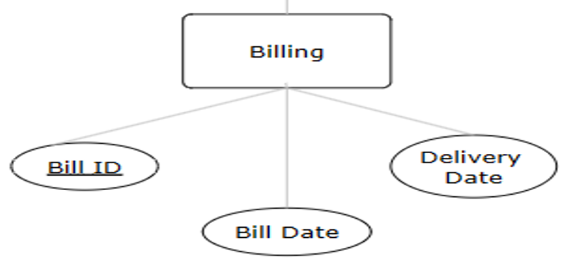
Our history
Schema
7

Slide 8
Conclusion
In conclusion, DBMS significantly elevates e-commerce by enabling personalized shopping, streamlined inventory management, and data-driven decisions. Its structured approach ensures a seamless and customer-centric online retail experience, paving the way for continued advancements in the industry.
8

Slide 9
Thank You
9

